Slide 1

SAP Cloud Platform – Cloud foundry training
Anurag Bajaj
Day 5

Slide 2
Agenda – Day 5
Create and Connect to SAP HANA
- Create HANA DB as a Service
- Understand HDI Deployer
- Connect to SAP HANA DB
- Adding App Router
- Understand microservices
- Build the MTAR Archieve
- Deploy and test app in cloud
--Break
S/4HANA Connection with SAP Cloud Platform
- Introduction to Extensibility
- Extensibility in past and now
- Introducing SAP S/4HANA Cloud SDK for Node JS
- Introduction to SAP Business API HUB
- Calling SAP S/4HANA Sales Order API using cloud-sdk
- Expose the v4 service layer
- Create user interface
QnA

Slide 3
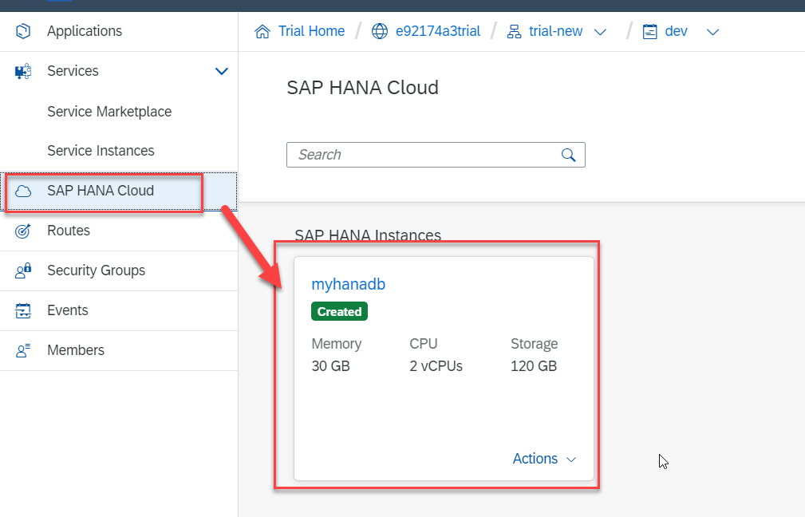
Hands-on: Create HANA DB Service in Cloud

Slide 4

HANA Deployment process
cds add hana
Package.json
“hana”: {“deploy-format”:”hdbtable”}
CAPM
.cds file
HANADB Artefacts
config
cds build --production
Hana-deployer
cds deploy –to hana
HDI
HANA

Slide 5
App Router
The application router is the single point-of-entry for an application running in the Cloud Foundry environment on SAP Cloud Platform. The application router is used to serve static content, authenticate users, rewrite URLs, and forward or proxy requests to other micro services while propagating user information.
The application router is a library that is available on npmjs.com (NPM). For more information, see @sap/approuter Information published on non-SAP site.
You can set up an run your own application router or you can use the application router that is managed by SAP (for more information see Managed Application Router). We recommend running you own application router only in advanced cases, for example when application router extensibility is required.

Slide 6
Hands-on: Add App Router to UI5 app
Add Application router dependency in the root app folder
npm install @sap/approuter
Change Start script in package.json of app
"start": "node node_modules/@sap/approuter/approuter.js"

Slide 7
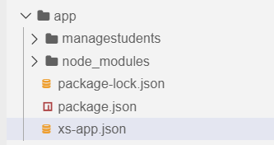
xs-app.json content
{
"welcomeFile": "managestudents/webapp/",
"authenticationMethod": "none",
"routes": [{
"source": "^/managestudents/webapp/(.*)$",
"target": "$1",
"localDir": "managestudents/webapp/"
}, {
"source": "^(.*)$",
"destination": "srv-api"
}]
}

Slide 8
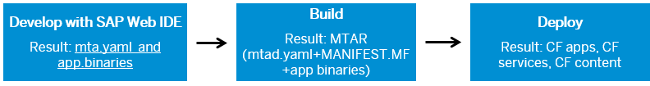
What is MTA
A Multi-Target Application (SAP MTA) is a package comprised of multiple libraries, application and resource modules. These have been created using different technologies and deployed to different runtimes but have a common life-cycle. You can bundle different modules together, describe them along with their inter-dependencies to other modules, services, and interfaces, and package them in an Multi-Target Application(MTA) .
A Multi-Target Application can have both UI5 and other open source app implementation. We can deploy Java, Node.js and all other SAP cloud platform services.
Development descriptors are used to generate MTA deployment descriptors, which define the required deployment data. That is, the MTA development descriptor data specifies what you want to build, how to build it, while the deployment descriptor data specifies as what and how to deploy it.
Click here for more on MTA

Slide 9
Hands-on Add UI module to MTA
Add a new mta.yml file using command
cds add mta
Open mta.yml file and add new UI Config
- name: capm3-ui
type: nodejs
path: app
requires:
- name: srv-api
properties:
forwardAuthToken: true
strictSSL: true
name: srv-api
url: ~{srv-url}
group: destinations
parameters:
disk-quota: 256M
memory: 256M

Slide 10
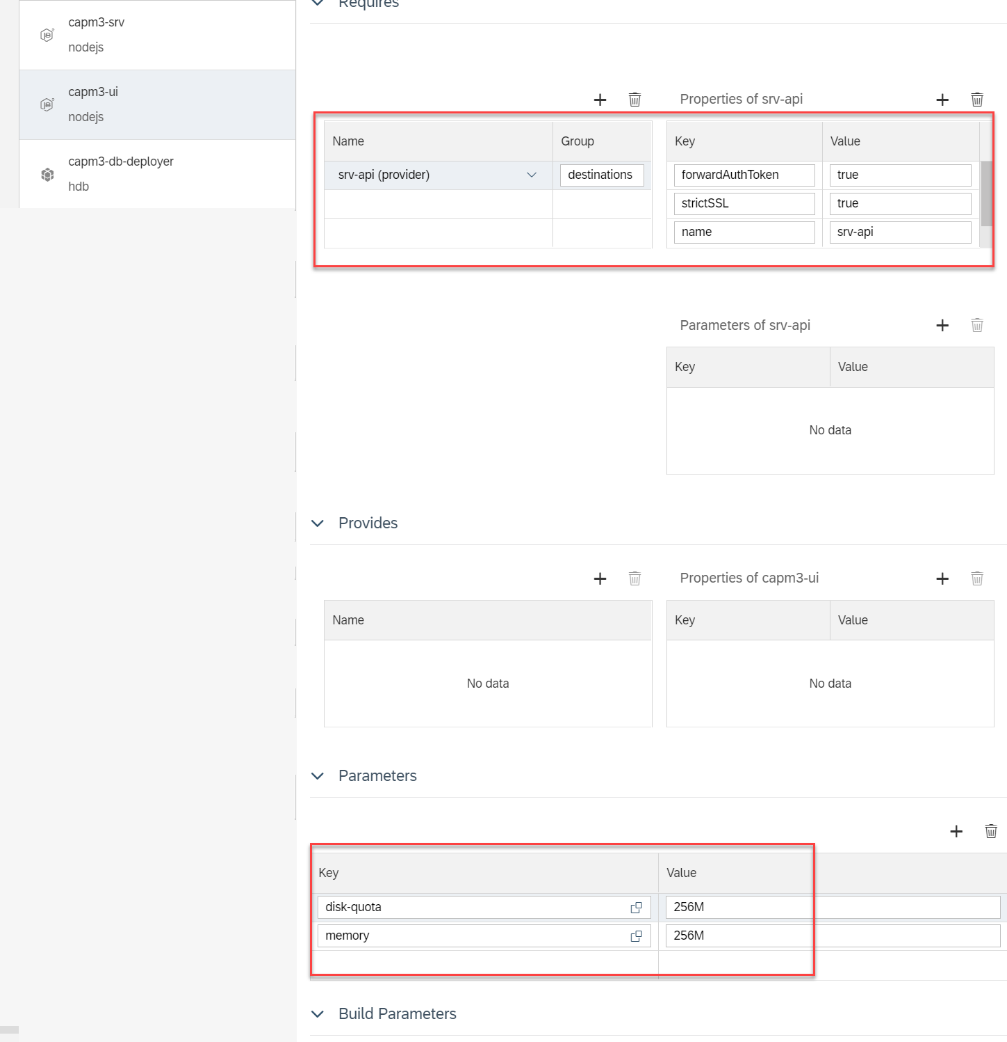
Open MTA Editor and maintain below settings

Slide 11
Hands-on Final Deployment to CF
Now the app is tested locally and bind to HDI service instance, we will use mta builder tool to build and deploy the app
Use following commands to build MTAR archieve
mbt
mbt build
cf target
Cf deploy mta_archieve/<your MTAR filename>.mtar
Cf apps to check all apps
Additionally we can also use BAS Menu options to build and deploy MTA.

Slide 12
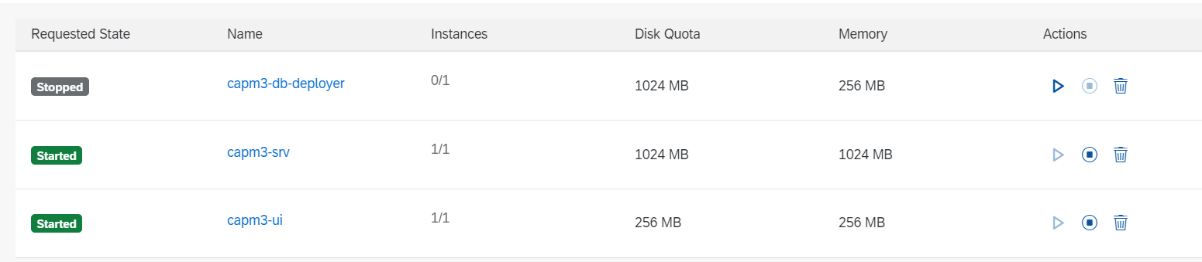
Final Result in CF

Slide 13
Break

Slide 14

Traditional ERP Challenges – Extension of Standard
Past the extension used to follow below process:
The functional team used to analyse the system and find the gaps.
Create a change request
Review → Approval process
Change order is created by CIO → staffing and commencement of project
Testing in sandbox and actual test client
Release change
Cons
Downtime
Risk on upgrade (DDIC, Code)
Contamination of stable Core
Grid locks to prevent the EHP failures
Long release cycles
Dev
Q
P
Dev
Q

Slide 15
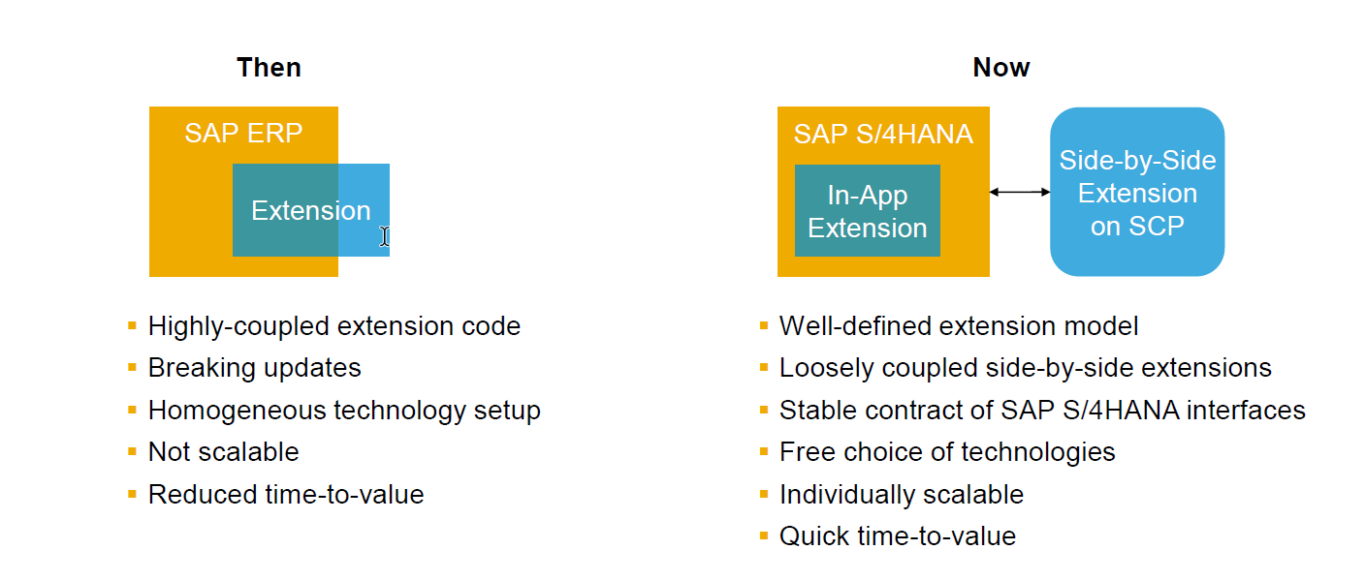
Extension Then and Now

Slide 16
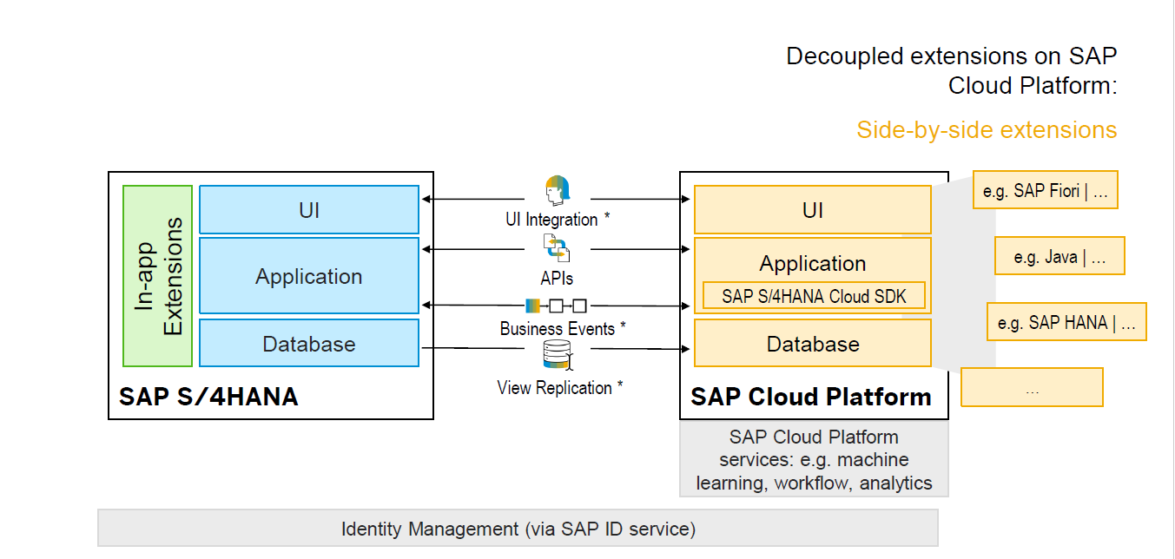
Side-by-side extension

Slide 17
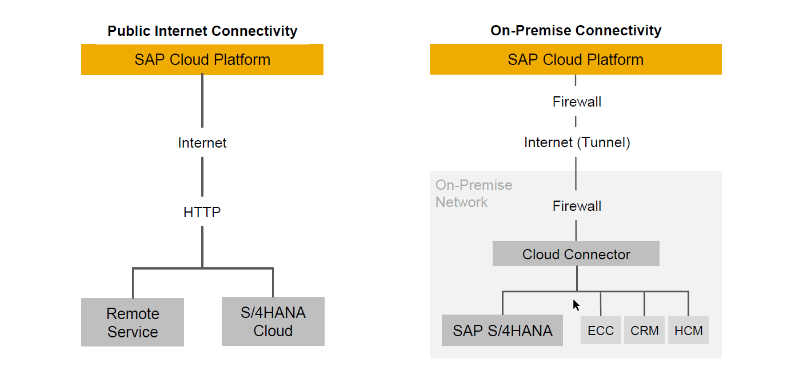
How do we connect to cloud?

Slide 18
What is APIHUB?
API stands for Application Programming Interface, every software solution tend to expose the contract so that other solutions can communicate to the software.
Old ERP system ECC – BAPI, Idoc, ALE, eCATT, BDC, LSMW, SHDB
APIHUB is a central place where we can find all the list of APIs offered in SAP solutions (cloud,OP) for the purpose of integration.
Find the API for integration (http://api.sap.com)
Go to product SAP S/4HANA Cloud
Search for the api
Test the api after login using sanbox
Explore entitysets, properties and odata options
If you find it useful, go to details to find
Communication scenario name
API End point
Login to your s/4 system
Create a communication
Create Communication user (technical user)
Create a communication arrangement using the standard comm. Scenario
Publish the arrangement

Slide 19
SAP Cloud SDK @sap-cloud-sdk/cli
The SAP Cloud SDK supports you end-to-end when developing applications that communicate with SAP solutions and services such as SAP S/4HANA Cloud, SAP SuccessFactors, and many others.
Using the SAP Cloud SDK, you can reduce your effort when developing an application on SAP Cloud Platform by building on best practices delivered by the SAP Cloud SDK. The SAP Cloud SDK can provide JavaScript libraries and project templates.
To create such an application we provide a command-line interface, that allows you to scaffold or enhance an application with the missing parts to use the SAP Cloud SDK.

Slide 20
Hands-on: Create an Extension app using Cloud-sdk
The SAP Cloud SDK supports you end-to-end when developing applications that communicate with SAP solutions and services such as SAP S/4HANA Cloud, SAP SuccessFactors, and many others.
Using the SAP Cloud SDK, you can reduce your effort when developing an application on SAP Cloud Platform by building on best practices delivered by the SAP Cloud SDK. The SAP Cloud SDK can provide JavaScript libraries and project templates.
To create such an application SAP provide a command-line interface, that allows you to scaffold or enhance an application with the missing parts to use the SAP Cloud SDK.
We can install same using below command
npm install -g @sap-cloud-sdk/cli

Slide 21
Hands-on continue..
- Create a new project using cds init
Install SAP Cloud SDK for node js @sap/cloud-sdk-core
Install the SAP SDK sales order API Module @sap/cloud-sdk-vdm-sales-order-service
- Create external folder inside the srv directory
- Download Sales Order API edmx file from api hub
- run cds watch on project and drop edmx inside folder, csn gets created
- create data-model.cds which has abstract entity
- create catalog-service.cds exposing the service from abstract entity
- create catalog-service.js to write hook method for read data from Sales orders in S/4HANA
- Expose the data out of CDS in JSON format by mapping to Entity of CDS
Source Code Library
https://github.com/soyuztechnologies/s4extapp

Slide 22
End of Day 5

Slide 23

Questions

Slide 24

Anurag Bajaj

